Slide 1
Front to Back…and return

Slide 2
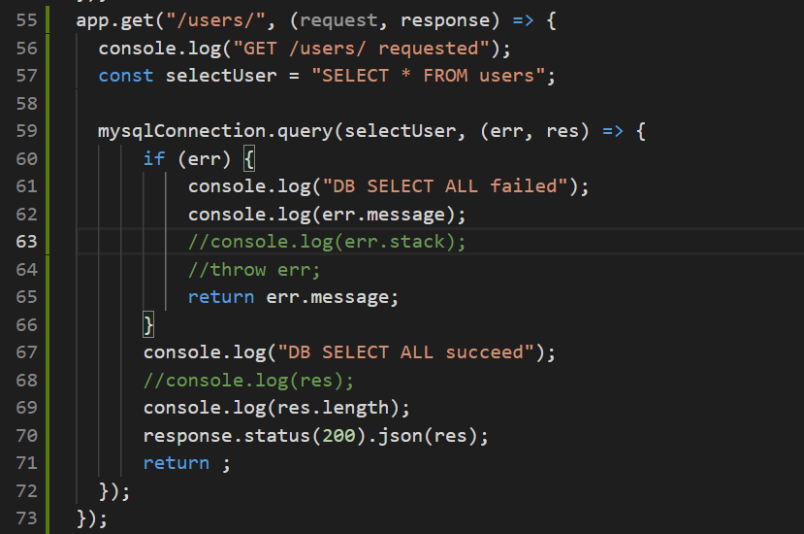
Gloubi code … is working
Callback 1 http response
Callback 2 db results
Utilisation response in cb2

Slide 3
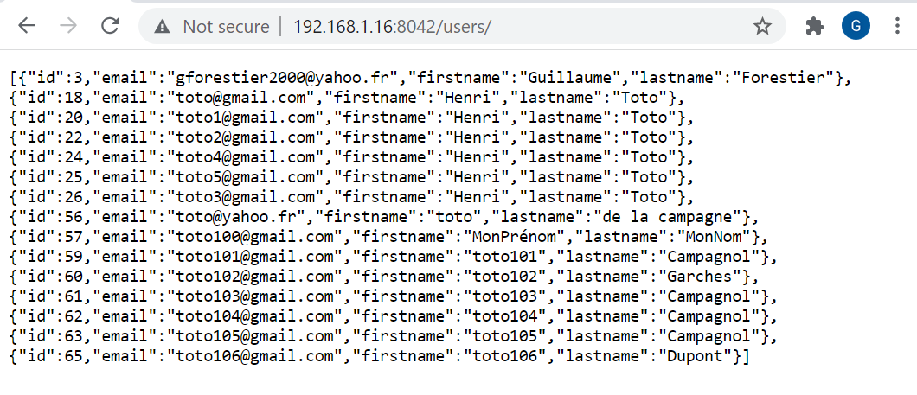
User perspective

Slide 5
